Slide 1

Restaurant Review Classifier
Gauging Customer Satisfaction Through Text Analysis
Using Machine Learning & Natural Language Processing (NLP)
Notes:
1

Slide 2

Our Team:
Meet the dedicated individuals behind this project
K. Dinesh - AP23110010082
B. Dheeraj - AP23110010406
B. Akash - AP23110010417
B. Nithin Sai - AP23110011394
A. Hemanth - AP23110010635
Notes:
2

Slide 3

Problem Statement
Restaurants receive a huge number of customer reviews across platforms like Yelp, Google Reviews, and social media. Manually analyzing them is time-consuming and inefficient. The restaurant chain needs an automated review classifier to quickly categorize feedback as positive or negative (“liked” or “not liked”).
Objectives
Automatically classify customer reviews as liked or not liked.
Help restaurants identify customer sentiments and areas needing improvement.
Improve overall service quality and customer satisfaction.
Enable data-driven decision making using NLP & Machine Learning.
To categorise reviews as 'Liked' or 'Not Liked' with high accuracy.
To support agile decision-making and respond to customer feedback efficiently.
To pinpoint areas for improvement and maintain consistent service quality across all branches.
Notes:
3

Slide 4

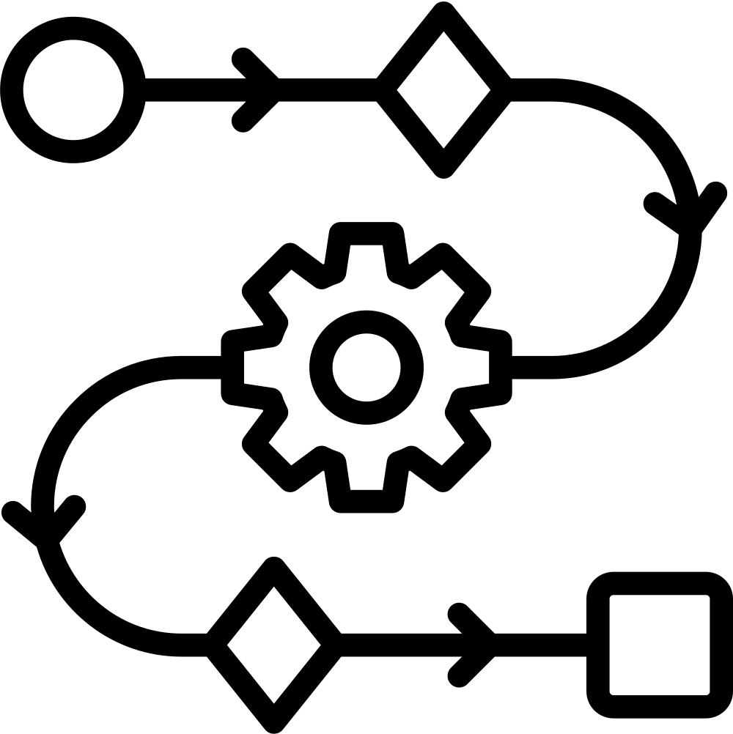
Proposed Solution
Build a machine learning model using Natural Language Processing (NLP) that:
Preprocesses customer reviews.
Converts text to numerical features.
Trains a classifier to categorize sentiments.
Predicts sentiment for new/unseen reviews.
Workflow
Data Loading
Text Preprocessing (stopwords removal, stemming)
TF-IDF Vectorization
Train-Test Split
Model Training (Logistic Regression)
Model Testing and Evaluation
Prediction on New Reviews
Notes:
4

Slide 5
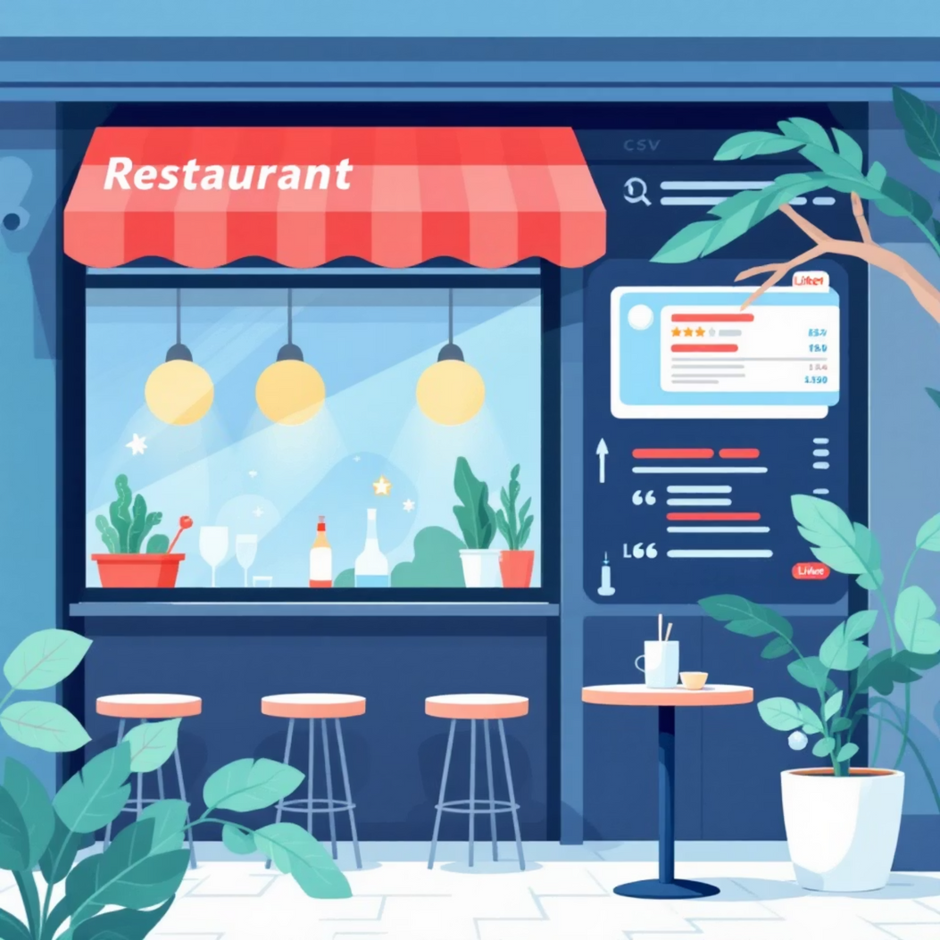
Dataset
File: Restaurant_Reviews.tsv
Format: Tab-Separated Values
Contains: Reviews + Label (1 = Liked, 0 = Not Liked)
Methodology
Use NLTK for:
Stopwords removal
Tokenization
Porter stemming
Use TF-IDF Vectorizer to convert text to numerical features.
Split data: 80% Training, 20% Testing
Apply Logistic Regression.
Notes:
6

Slide 6



Technologies Used
We utilise a blend of powerful programming languages, development environments, and specialised libraries to build our classifier.
1
2
3
Programming & Environment
Core Libraries
Machine Learning Framework
Python: The backbone of our machine learning pipeline.
NumPy: For numerical operations.
Scikit-Learn: Comprehensive tools for ML:
pandas: For data manipulation and analysis.
Jupyter Notebook / Google Colab: For interactive development and experimentation.
TfidfVectorizer
NLTK: For advanced text processing (stopwords, stemming).
train_test_split
logisticregression
Notes:
7

Slide 7

Results
Model successfully trained on TF-IDF transformed text data.
Logistic Regression gave good accuracy for binary text classification.
Able to correctly classify sentiment in most cases.
Example:
Input: “Not tasty and the texture was just nasty”
Model Prediction: Not liked
Findings
The sentiment model achieved 74% accuracy, performing strongly for negative review detection.
Positive reviews showed high precision but lower recall, meaning some positives were missed.
Aspect-based analysis successfully identified sentiment for food, service, ambience, hygiene, speed, and price using keyword-based extraction.
Probability scores from provided confidence levels, improving interpretability.
The system offers a complete workflow—preprocessing, classification, aspect extraction, and UI display—making it practical for real restaurant review analysis.
Notes:
8

Slide 8

Conclusion
The automated restaurant review classifier:
Efficiently categorizes customer sentiments.
Saves manual effort and enables quick analysis.
Helps maintain high service quality across multiple locations.
Provides actionable insights for business improvements.
Notes:
9

Slide 9





Future Scope: Expanding Horizons
Our project lays a strong foundation for future advancements and broader applications in customer sentiment analysis.
Deployment
Advanced Models
Multi-class Sentiment
Deploy the classifier as a user-friendly web or mobile application for wider accessibility.
Explore sophisticated models like SVM, LSTM, or BERT for enhanced accuracy and deeper insights.
Extend classification to multiple sentiment categories, ranging from "very positive" to "very negative".
Real-time Monitoring
Interactive Dashboard
Integrate with Google/Yelp APIs for real-time review monitoring and instant feedback analysis.
Develop a comprehensive dashboard for managers to track sentiment trends and performance metrics dynamically.
Notes:
10

Slide 10

Notes:
6

